Slide 1
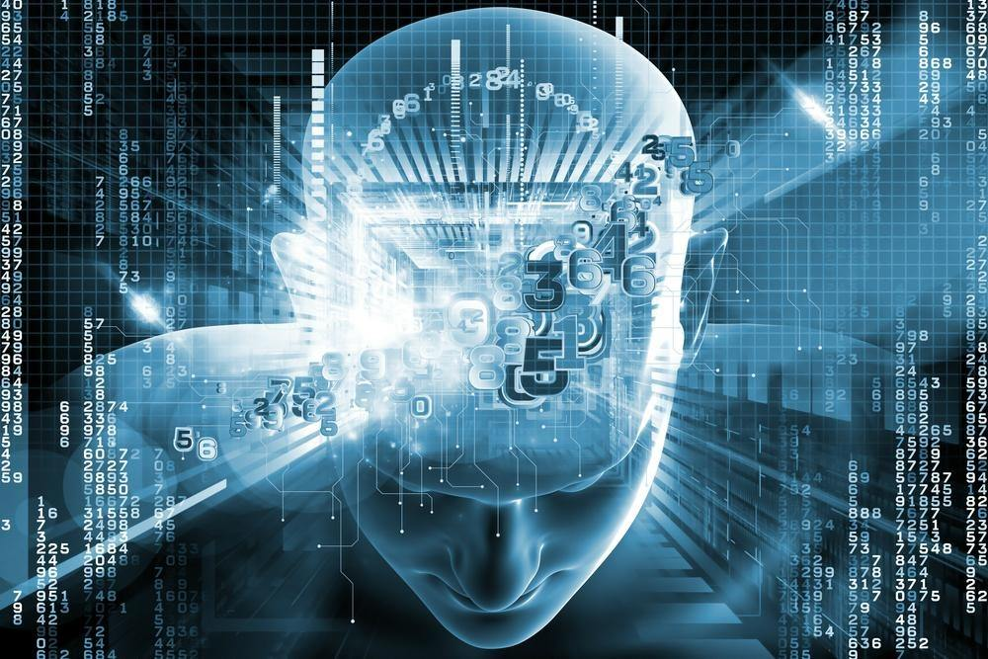
Programming for Machine Learning
Course Information
Pramote Kuacharoen

Slide 2
Instructor
Name
Pramote Kuacharoen
Office
Navamindradhiraj Building, Room 1333
Office hours
Wed 09:00AM-12:00PM
Thu 09:00AM-12:00PM
Homepage
http://as.nida.ac.th/~pramote/
Email
pramote@as.nida.ac.th
Social Network
http://www.facebook.com/pramote.kuacharoen

Slide 3
TA
Name
TBA
Email
TBA

Slide 4
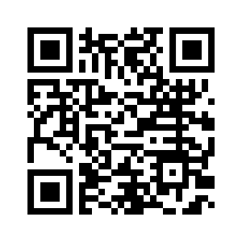
Class
Meeting
Section R1: Wednesdays 01:00PM-04:00PM, Navamindradhiraj Building, Lab 1
Section B1: Sundays 09:00AM-12:00PM, Siam Boromrajakumari Building, Lab 2
Prerequisite
BADS 6005 Applied Machine Learning or Instructor Consent
Facebook
https://www.facebook.com/groups/256201bads7201/

Slide 5
Textbook

Slide 6
Grading Policy
Projects 60%
Midterm 20%
Final 20%

Slide 7
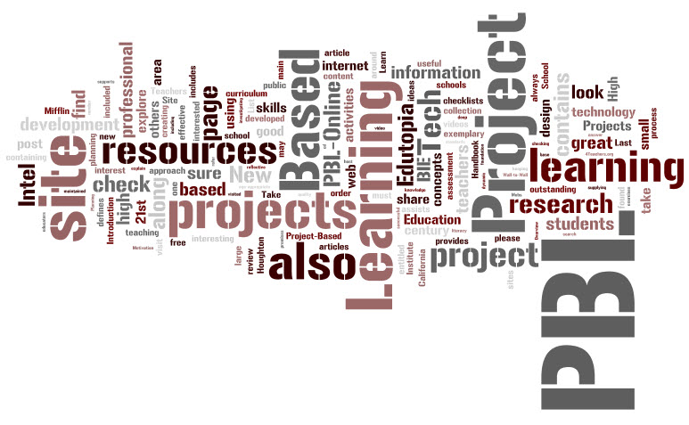
Learning & Teaching Activities
Lectures
Group discussions
Project based learning

Slide 8

Class Disruption
Audible devices must be shut off

Slide 9

Late Submission Policy
10% reduction of project points for each late day

Slide 10
Academic Integrity
Academic dishonesty will not be tolerated
An F for the course for all students involved in cheating

Slide 11
Class Participation
Ask questions
Make suggestions

Slide 12
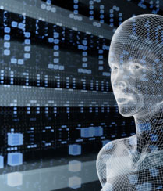
Course Description
Practices in programming for machine learning, programming for modifying and tuning parameter in machine learning algorithms, programming from machine learning algorithms.
12

Slide 13
Expected Learning Outcomes
On successful completion of this course, students should be able to:
Write machine learning algorithms in Python
Modify and tune parameters in machine learning algorithms
Apply machine learning algorithms to solve problems

Slide 14
Tentative Schedule
Week | Topics
1 | Introduction, Python Crash Course, Numpy, Pandas, Data Visualization
2 | Regression Algorithms
3 | Linear Classification
4 | Naïve Bayes and Discriminant Analysis
5 | Support Vector Machines
6 | Decision Trees and Ensemble Learning
7 | Clustering
8 | Hierarchical Clustering
9 | Recommendation Systems
10 | Natural Language Processing
11 | Neural Networks
12 | Deep Learning
13 | Reinforcement Learning
14 | Semi-Supervised Learning
15 | Graph-Based Semi-Supervised Learning

Slide 15
Questions?
Insert Image

